Slide 1
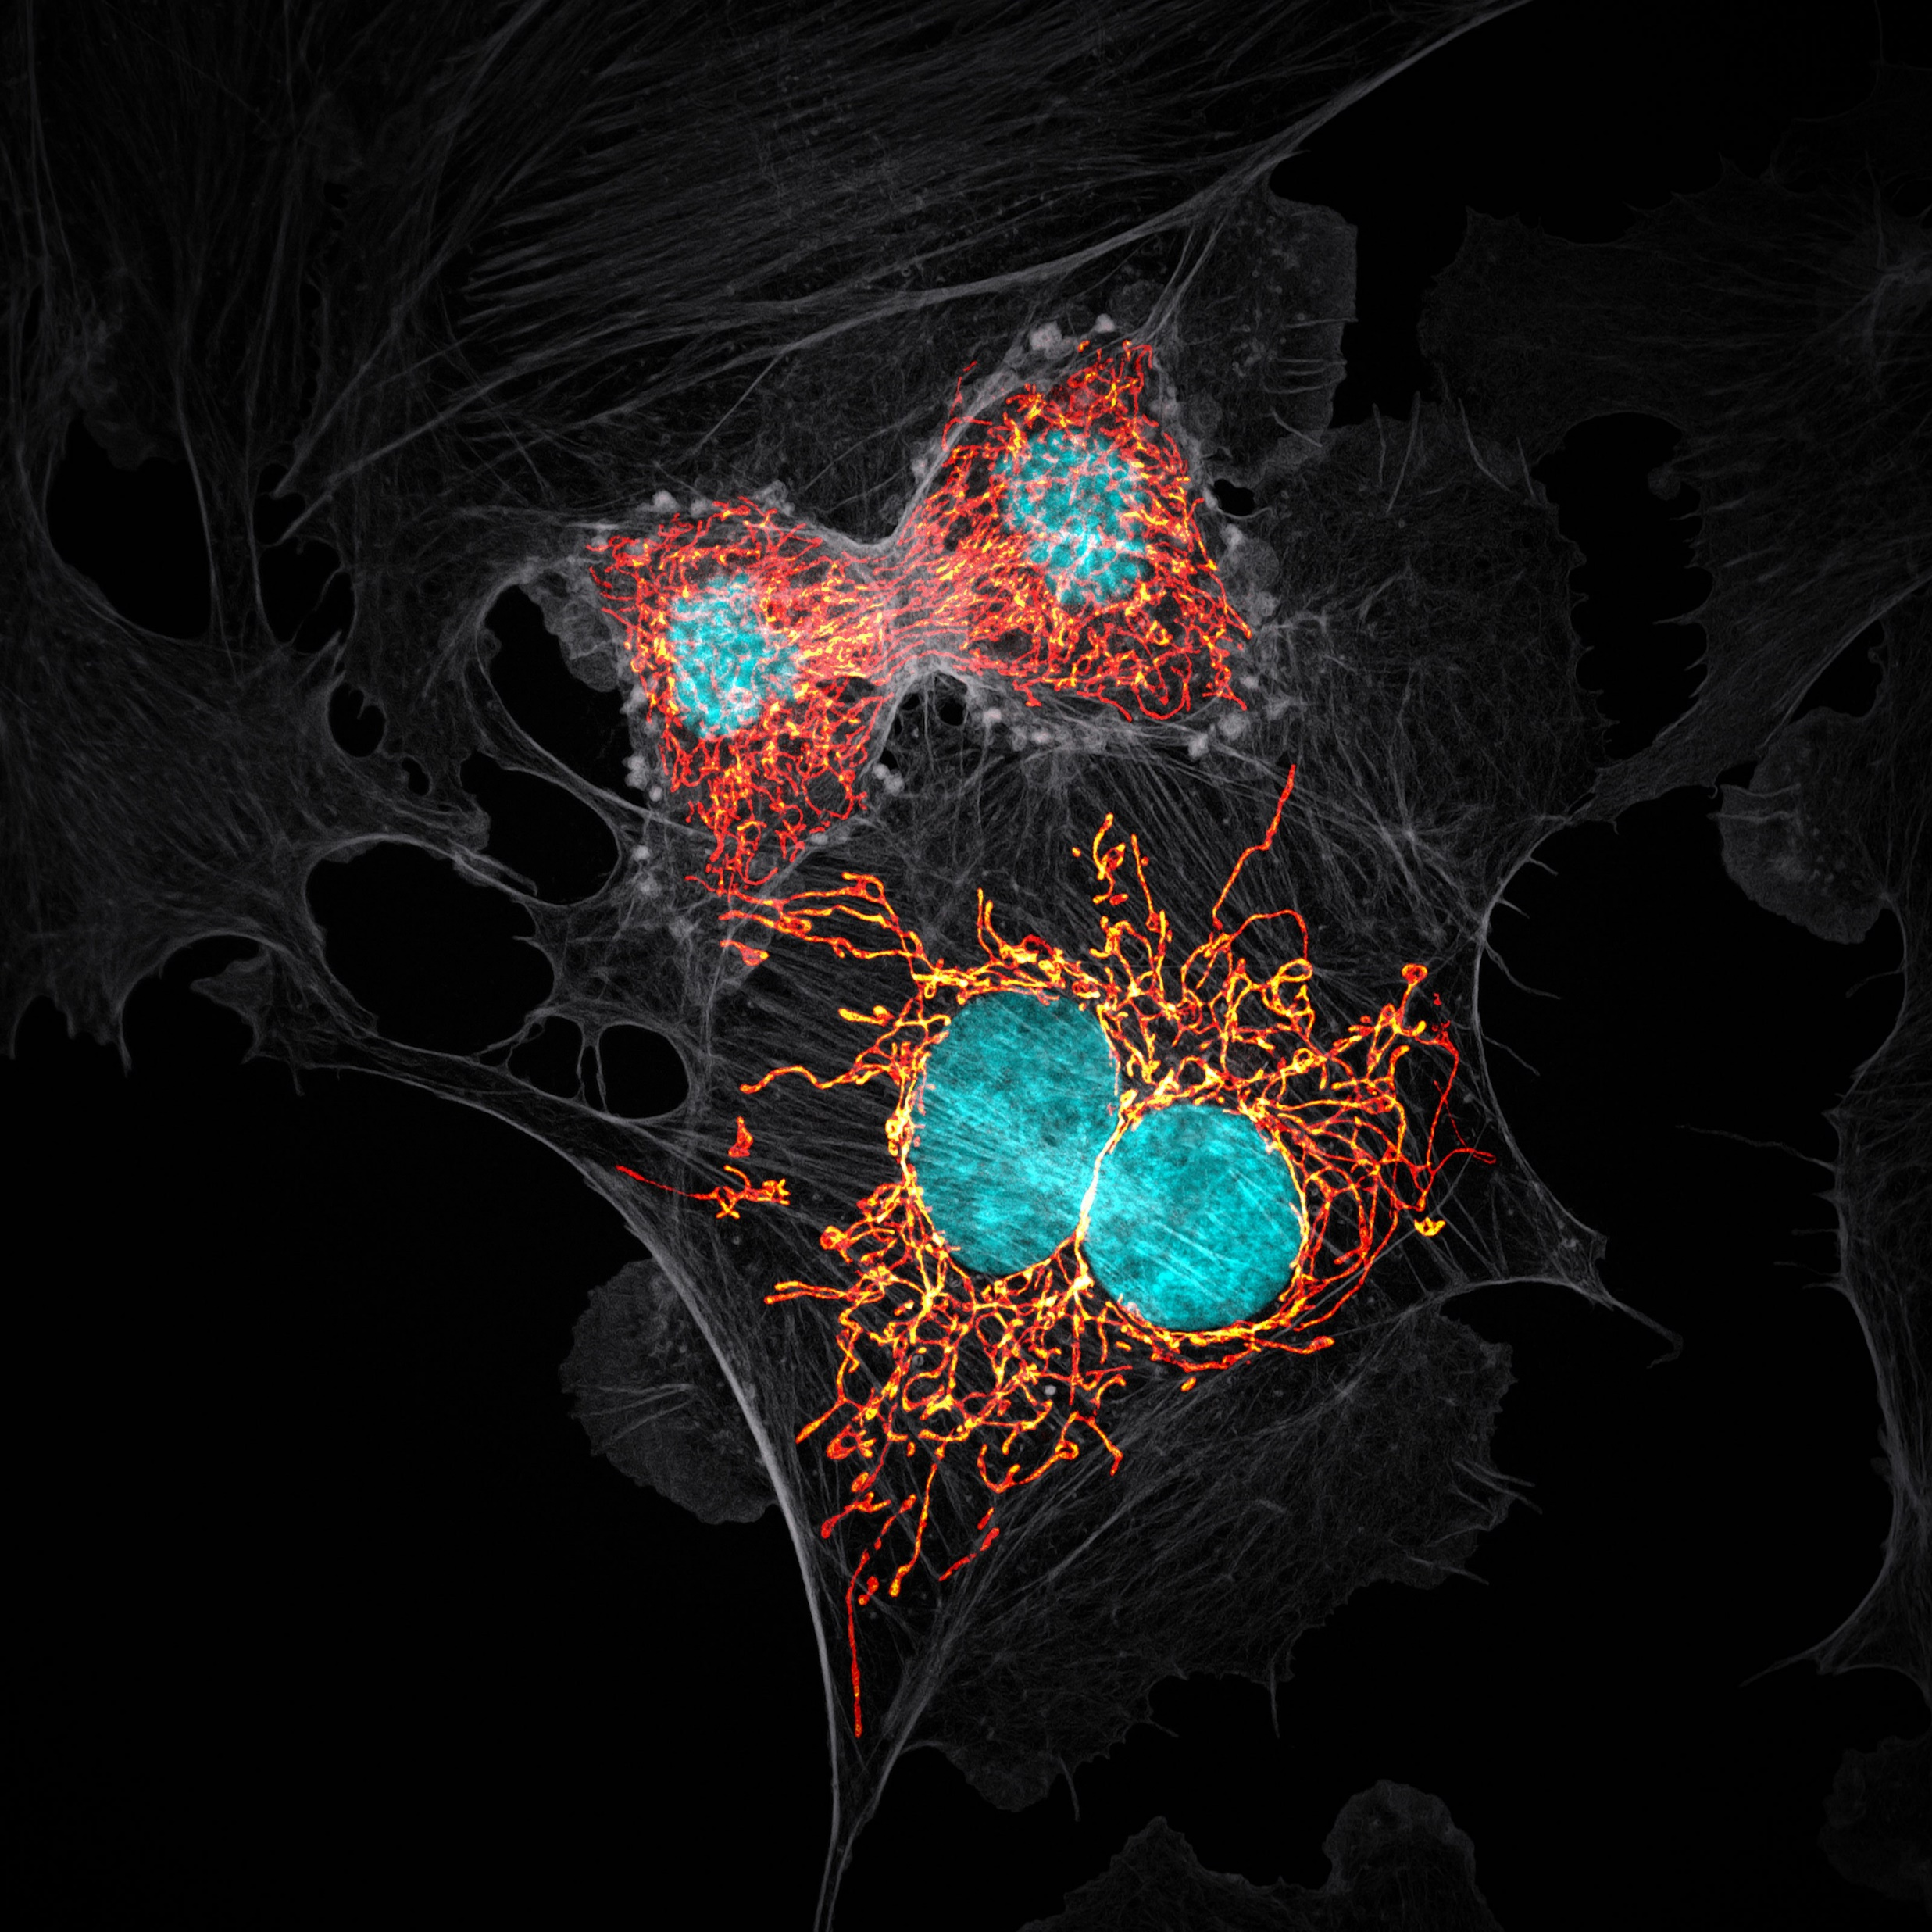

Seeing Is Not Believing
Image Credit: Jason Kirk - Baylor College of Medicine
Nikon Small World 2019 Prize Winner
The Case For Automating Image Analysis
Dave Barry • Francis Crick Institute

Slide 2


Slide 3
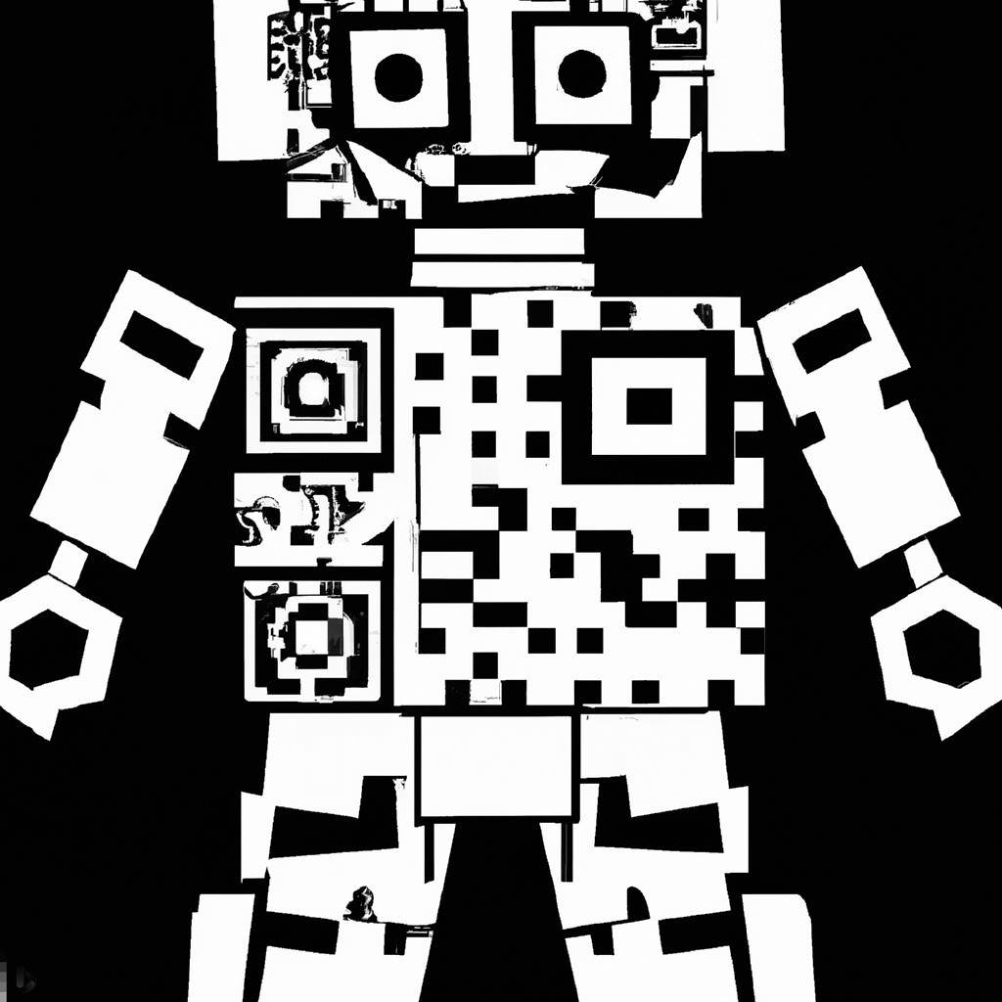
Have your phones ready to scan!

Slide 4
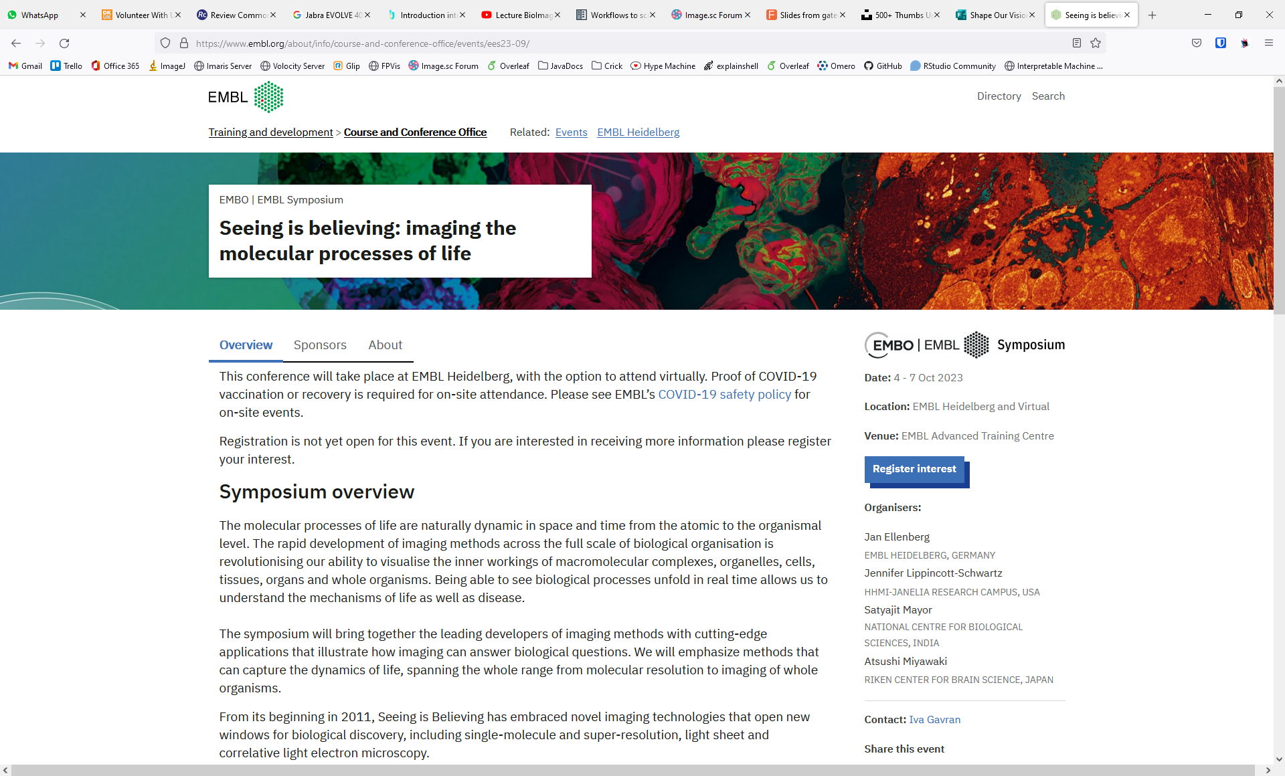

Slide 6
Rule #1: Seeing is believing

Slide 7
Rule #1: Seeing is believing?

Slide 8
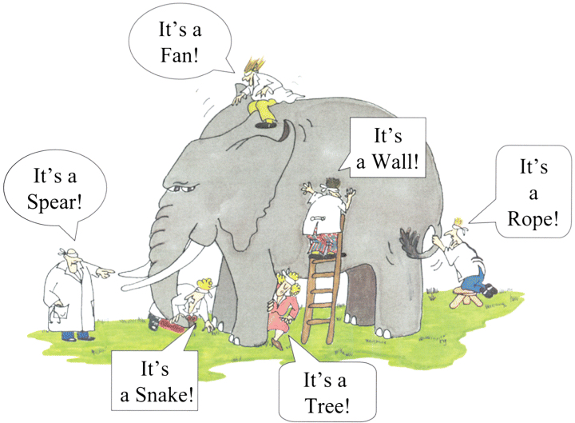

Slide 9
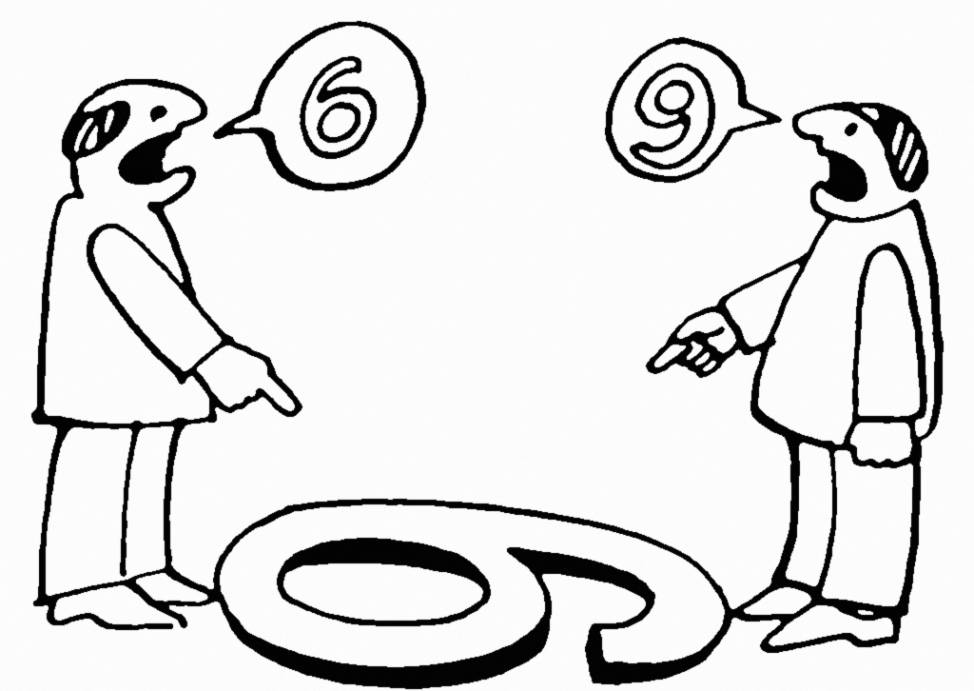
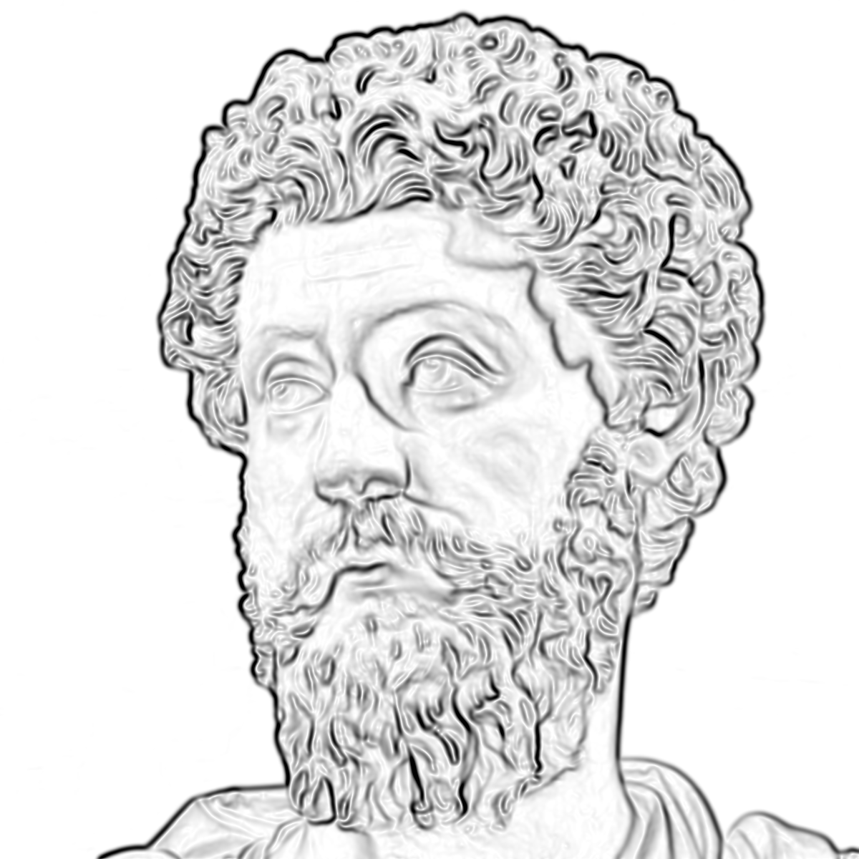
Everything we see is a perspective, not the truth

Slide 10


Slide 11


Slide 12



Slide 13
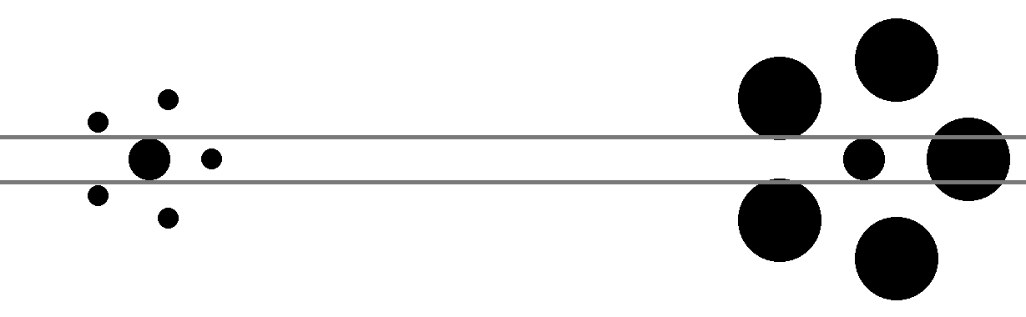


Slide 14
Rule #1: Seeing is believing?

Slide 15
Rule #1: Seeing is not believing

Slide 16
Rule #2: The image is not the result

Slide 17
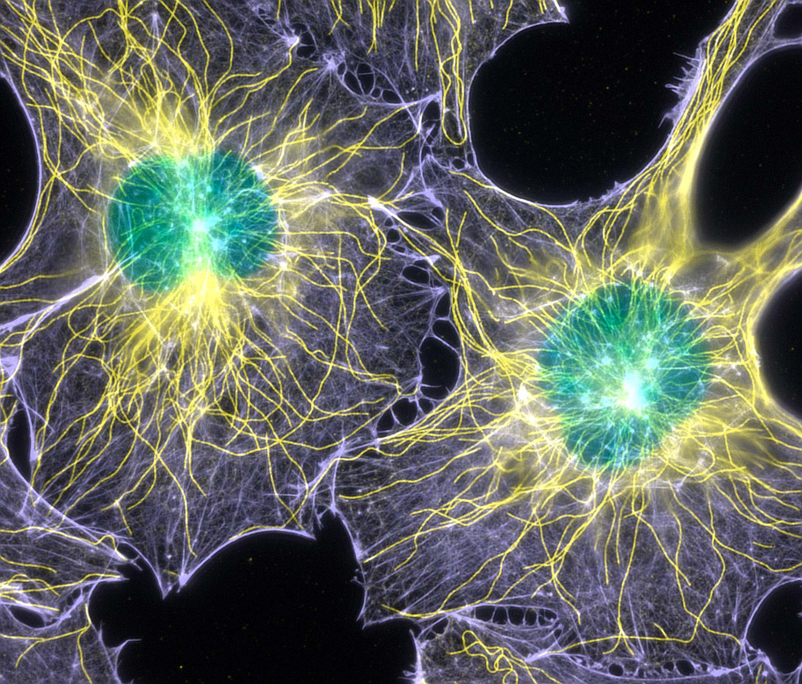
Credit: Torsten Wittmann - Scripps Research Institute
Nikon Small World 2003 Prize Winner

Slide 18
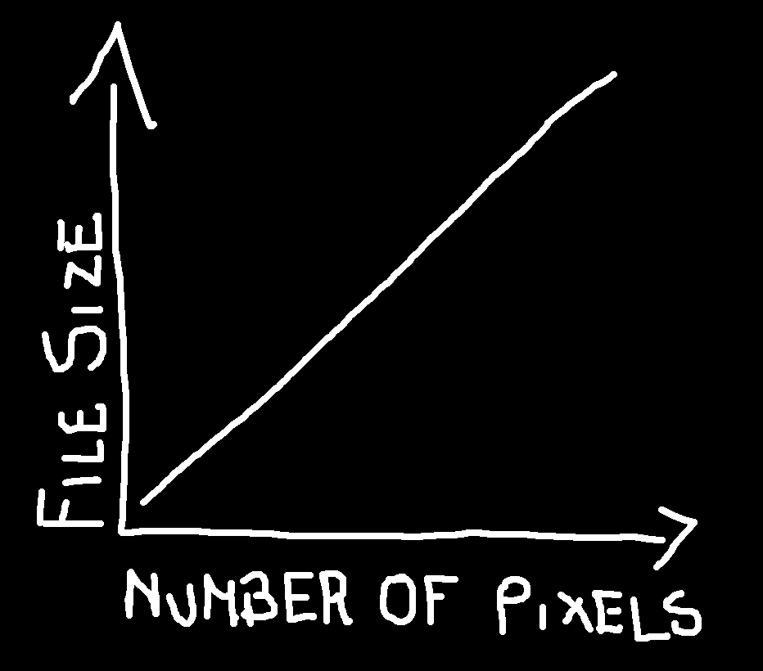

Slide 19
Credit: Torsten Wittmann - Scripps Research Institute
Nikon Small World 2003 Prize Winner

Slide 20
Rule #3: Analysing “by eye” is a really bad idea

Slide 21


Slide 22
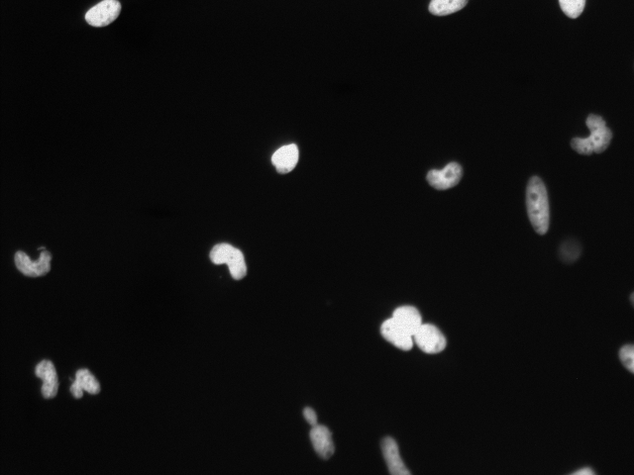
First Quiz: How many nuclei are there?
Notes:
5 minutes, 0 points

Slide 23
First Quiz: How many nuclei are there?
Notes:
5 minutes, 0 points

Slide 24
First Quiz: How many nuclei are there?
Notes:
5 minutes, 0 points

Slide 25
First Quiz: How many nuclei are there?
Notes:
5 minutes, 0 points

Slide 26
First Quiz: How many nuclei are there?
Notes:
5 minutes, 0 points

Slide 27
First Quiz: How many nuclei are there?
Notes:
5 minutes, 0 points

Slide 28
First Quiz: How many nuclei are there?
Notes:
5 minutes, 0 points

Slide 29
First Quiz: How many nuclei are there?
Notes:
5 minutes, 0 points

Slide 30
First Quiz: How many nuclei are there?
Only count round objects
Don’t count objects at edge of image
Don’t count objects below a certain intensity level
Don’t count clumps of objects as one
Notes:
5 minutes, 0 points

Slide 31
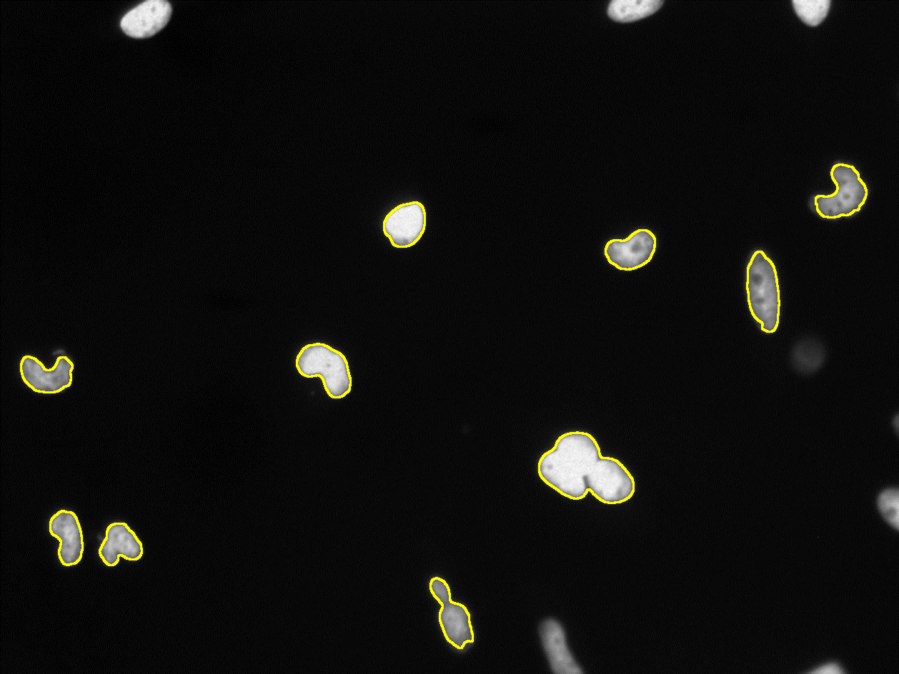
First Quiz: How many nuclei are there?
run("Median...", "radius=2");
setAutoThreshold("IsoData dark no-reset");
run("Convert to Mask");
run("Analyze Particles...", "show=Outlines exclude summarize");
Notes:
5 minutes, 0 points

Slide 32
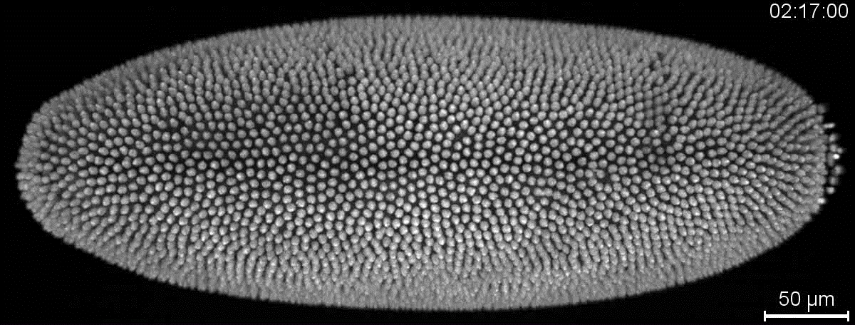
Amat et al., Nat Meth, 2014

Slide 33
Rule #4: Image analysis is hard…

Slide 34
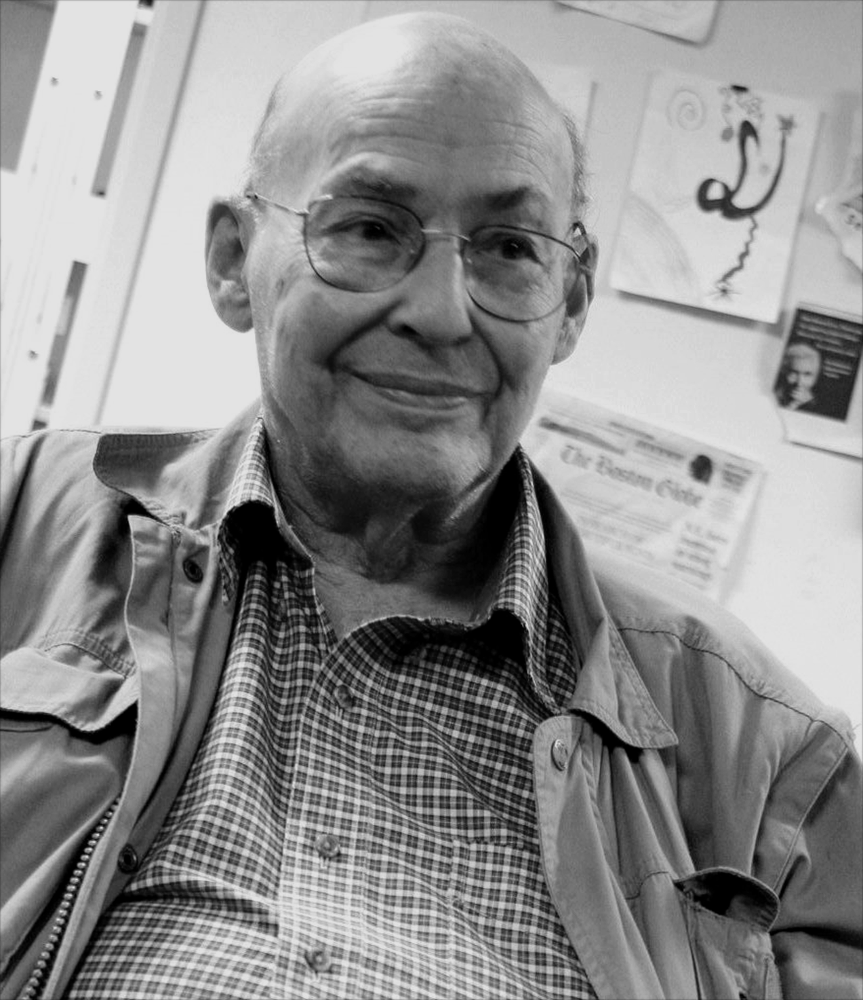
“Connect a camera to a computer and have it describe what it sees”
Marvin Minsky, 1966

Slide 35

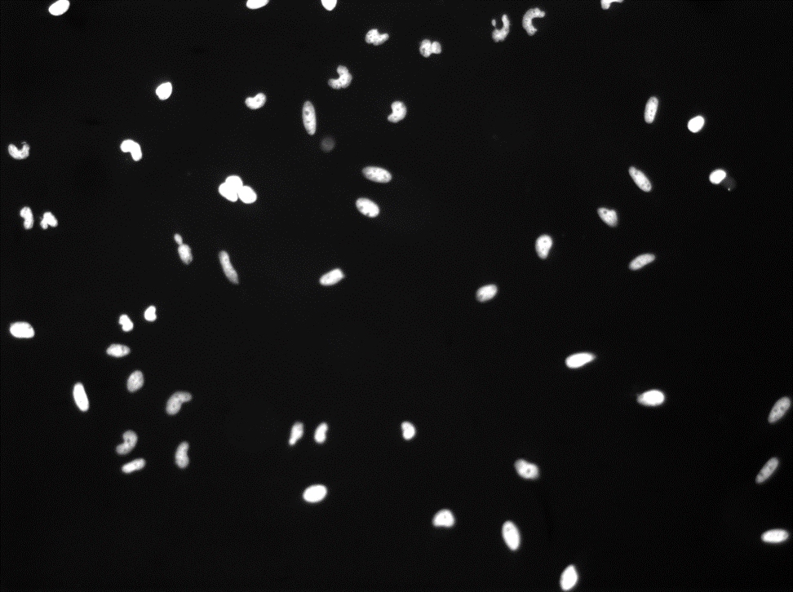

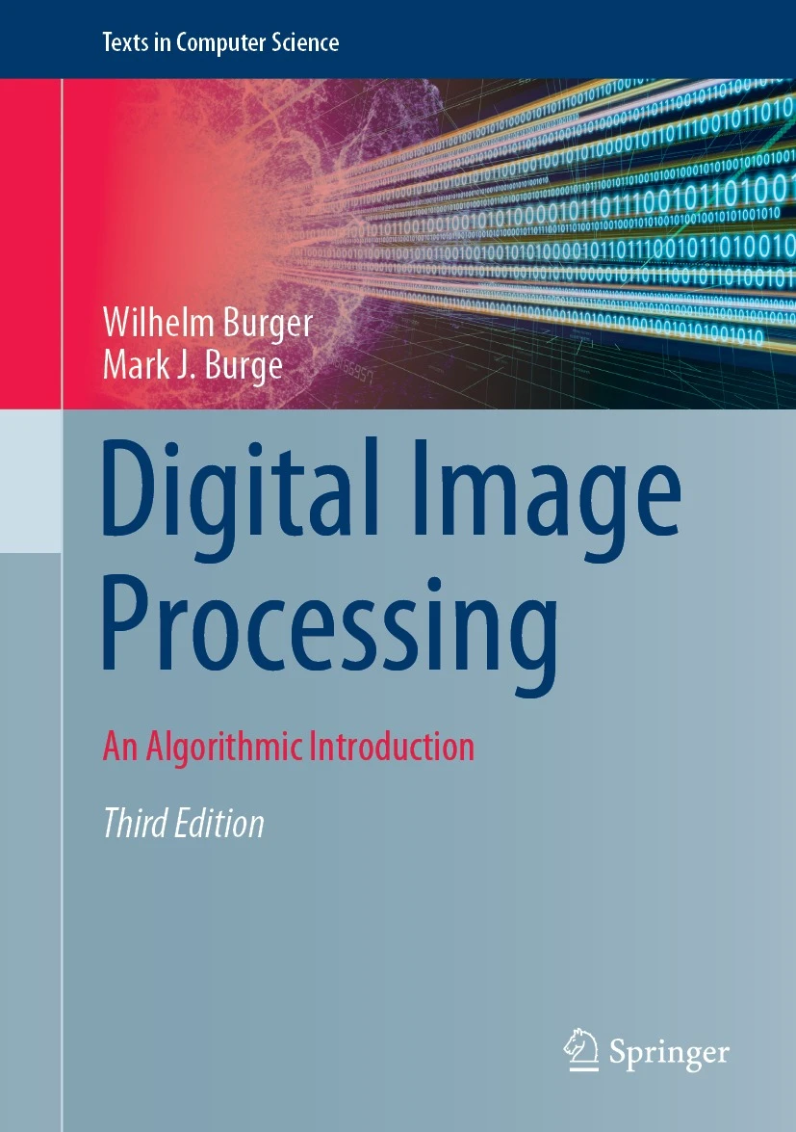
“Solutions to image analysis problems often appear simple, particularly when easily accomplished by the human visual system, which is complex and poorly understood.”

Slide 36
Rule #5: Manage your expectations

Slide 37
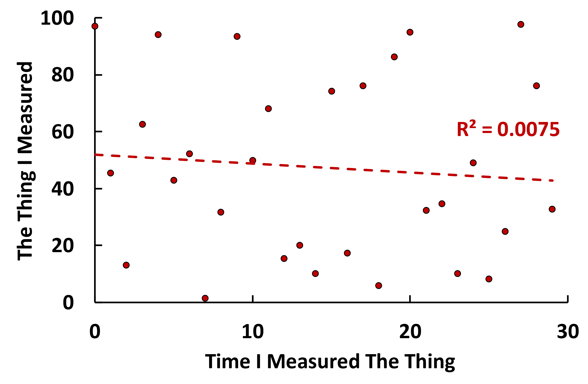
Design Experiment
Prepare Samples
Acquire Images
Analyse Images

Slide 38

Design Experiment
Prepare Samples
Acquire Images
Analyse Images
DESPAIR

Slide 39
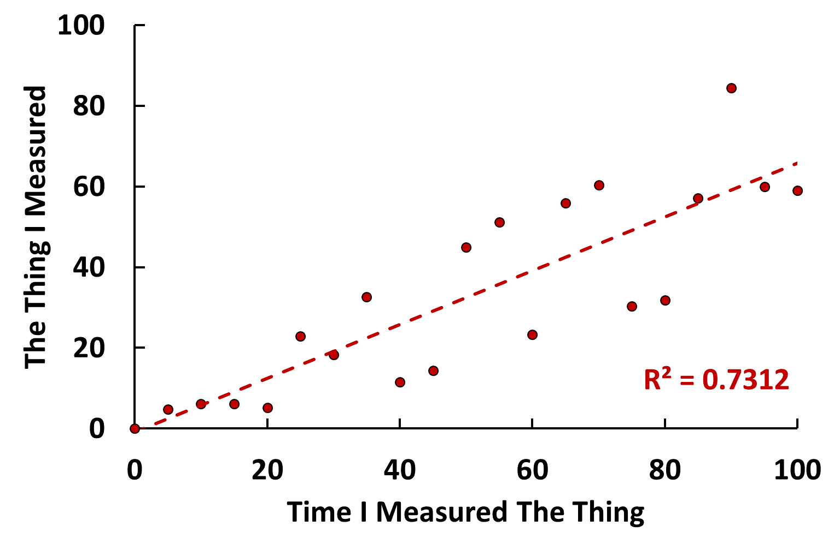

Design Experiment
Prepare Samples
Acquire Images
Analyse Images
GLIMMER OF HOPE

Slide 40

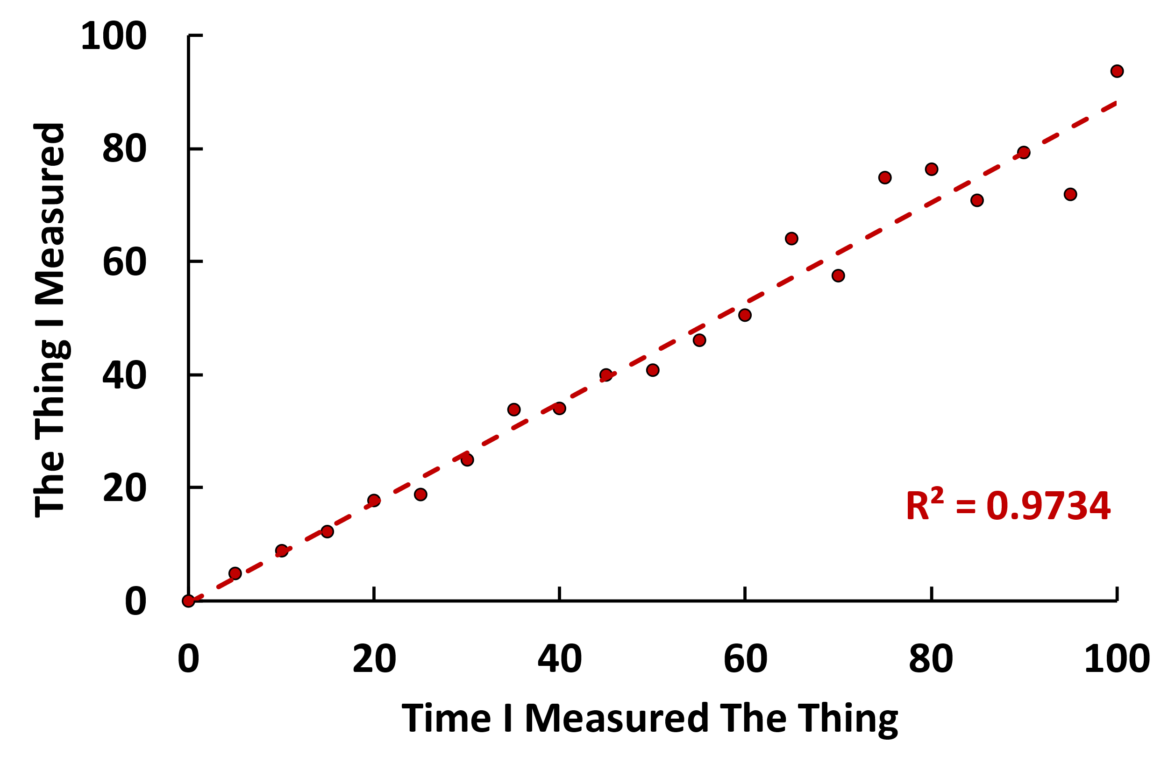

Slide 41
Rule #6: Perfect is the enemy of good

Slide 42
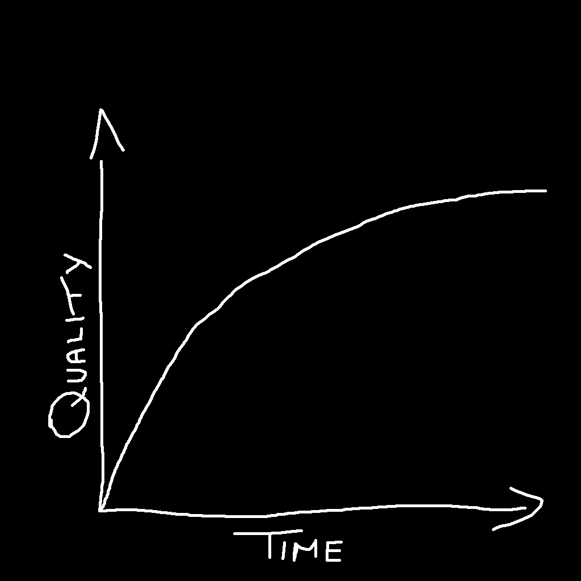
When do I know when my image analysis is good enough?

Slide 43


Everyone makes mistakes

Slide 44
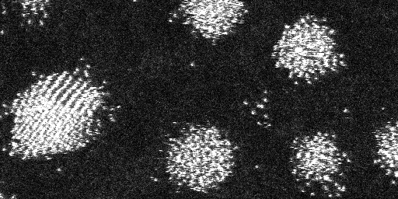


Everyone makes mistakes

Slide 46
Rule #7: Crap In = Crap Out

Slide 47
Crap Images
Super Cool, State-of-the-Art, Cutting Edge Image Analysis Pipeline
Crap

Slide 48


Crap Images

Slide 49
Compulsory Slides on Machine Learning

Slide 50
Rule #8: AI is but one of many tools

Slide 51
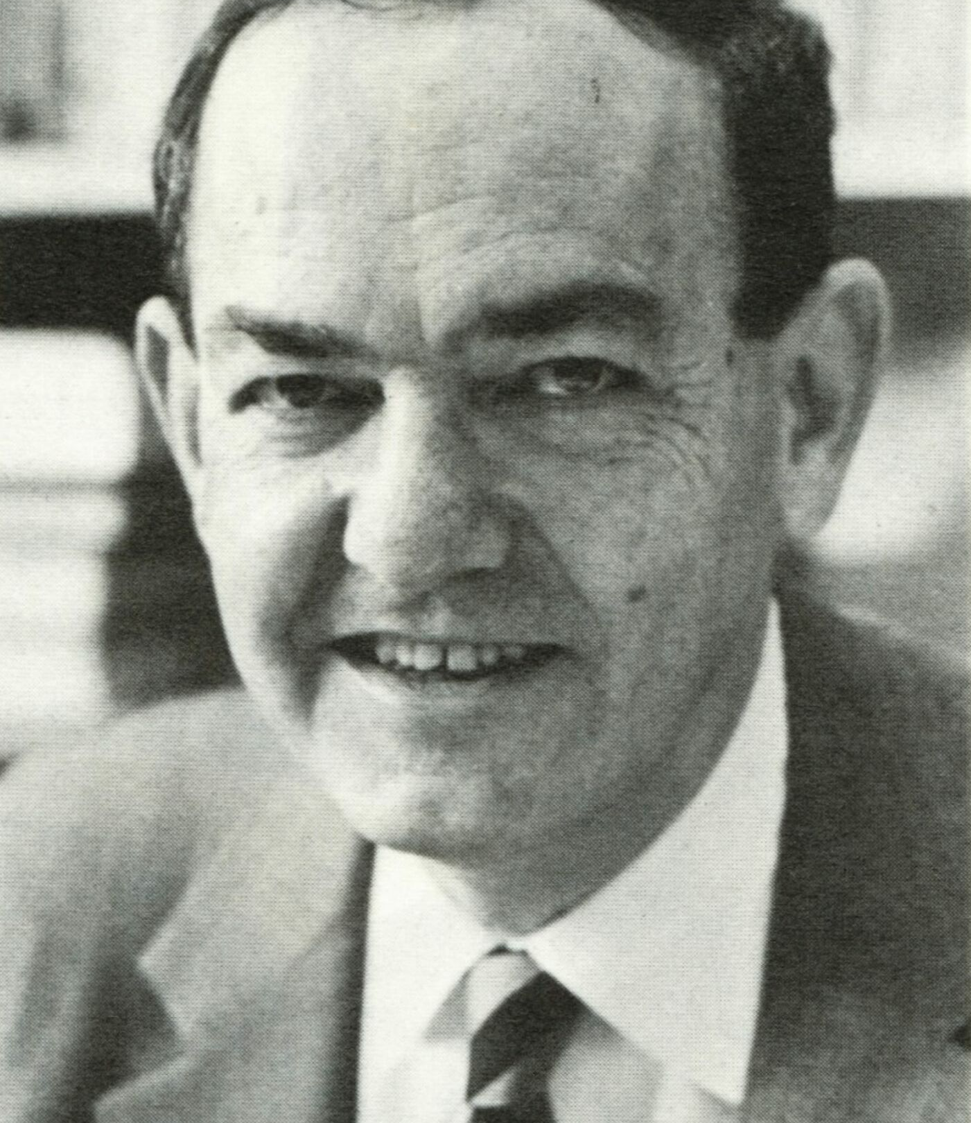
“machines will be capable, within twenty years, of doing any work a man can do”
Herbert Simon, 1965

Slide 52
“Conventional” Pipeline
AI Pipeline

Slide 53
Rule #9: Use the right tool for the right job

Slide 54
FIJI
QuPath
ilastik
CellProfiler
Jupyter
napari

Slide 55
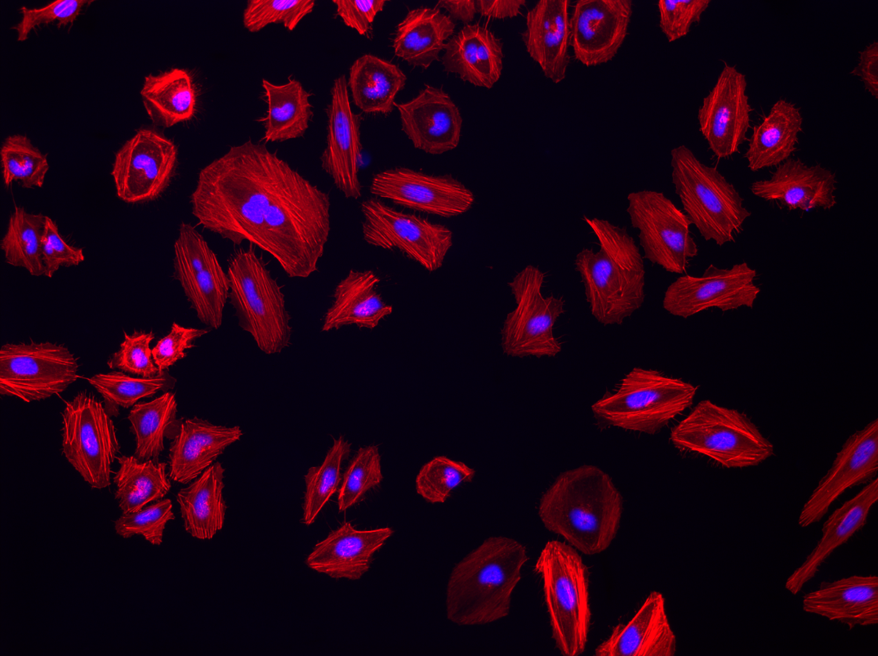
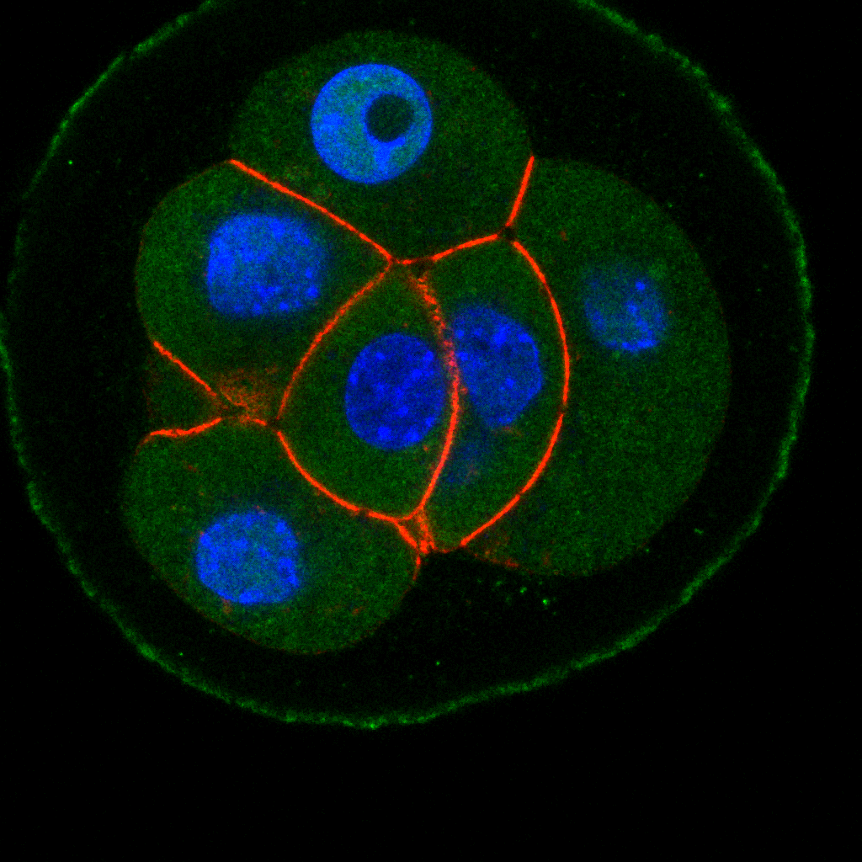
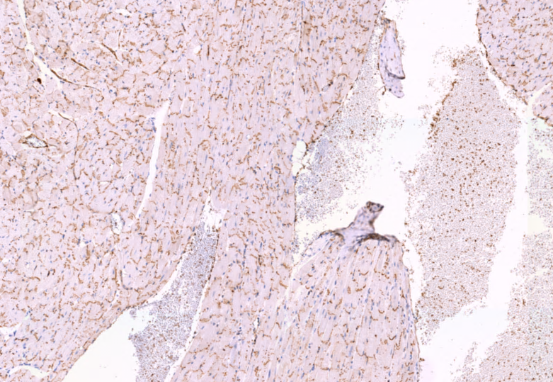
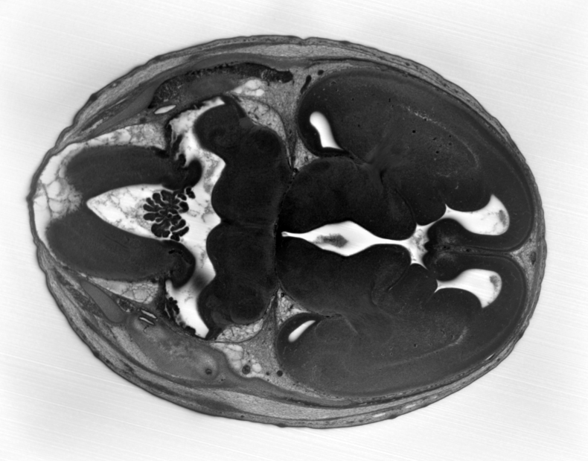

Slide 56
Rule #10: Ask For Help!

Slide 57
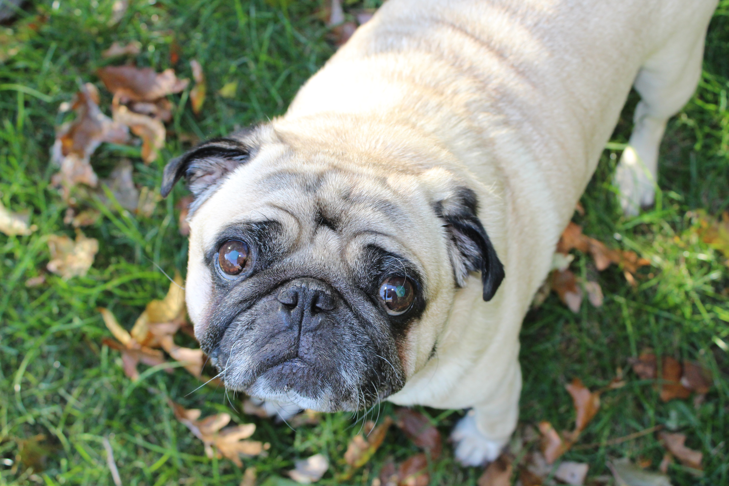

I have literally no idea what I’m doing…

Slide 58
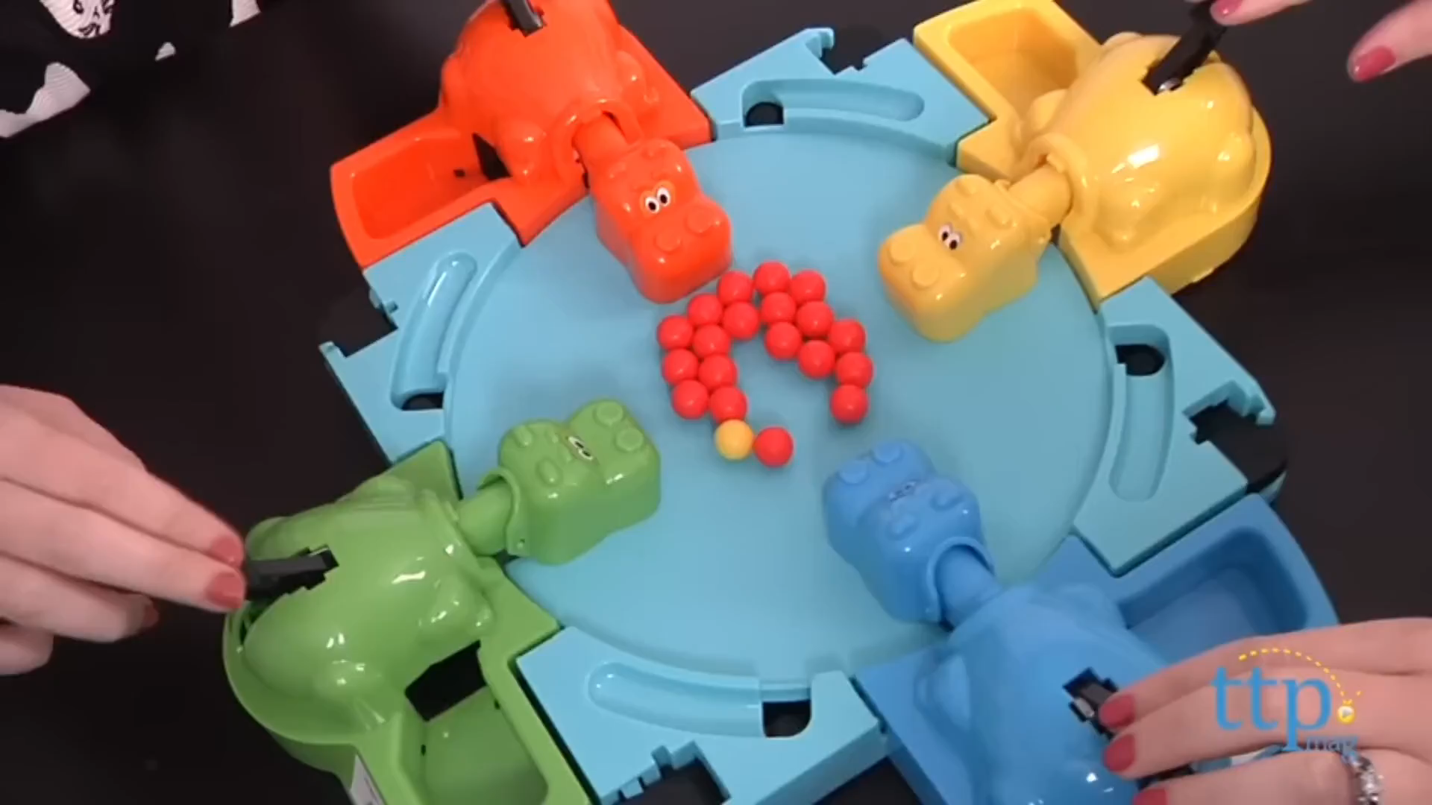
Now we have ALL the data!!!
Ok, now what?
Naughty Scientists
Microscopy Images
DEEP LEARNING!!!

Slide 59

forum.image.sc

Slide 60


20 – 21 November 2023

Slide 61
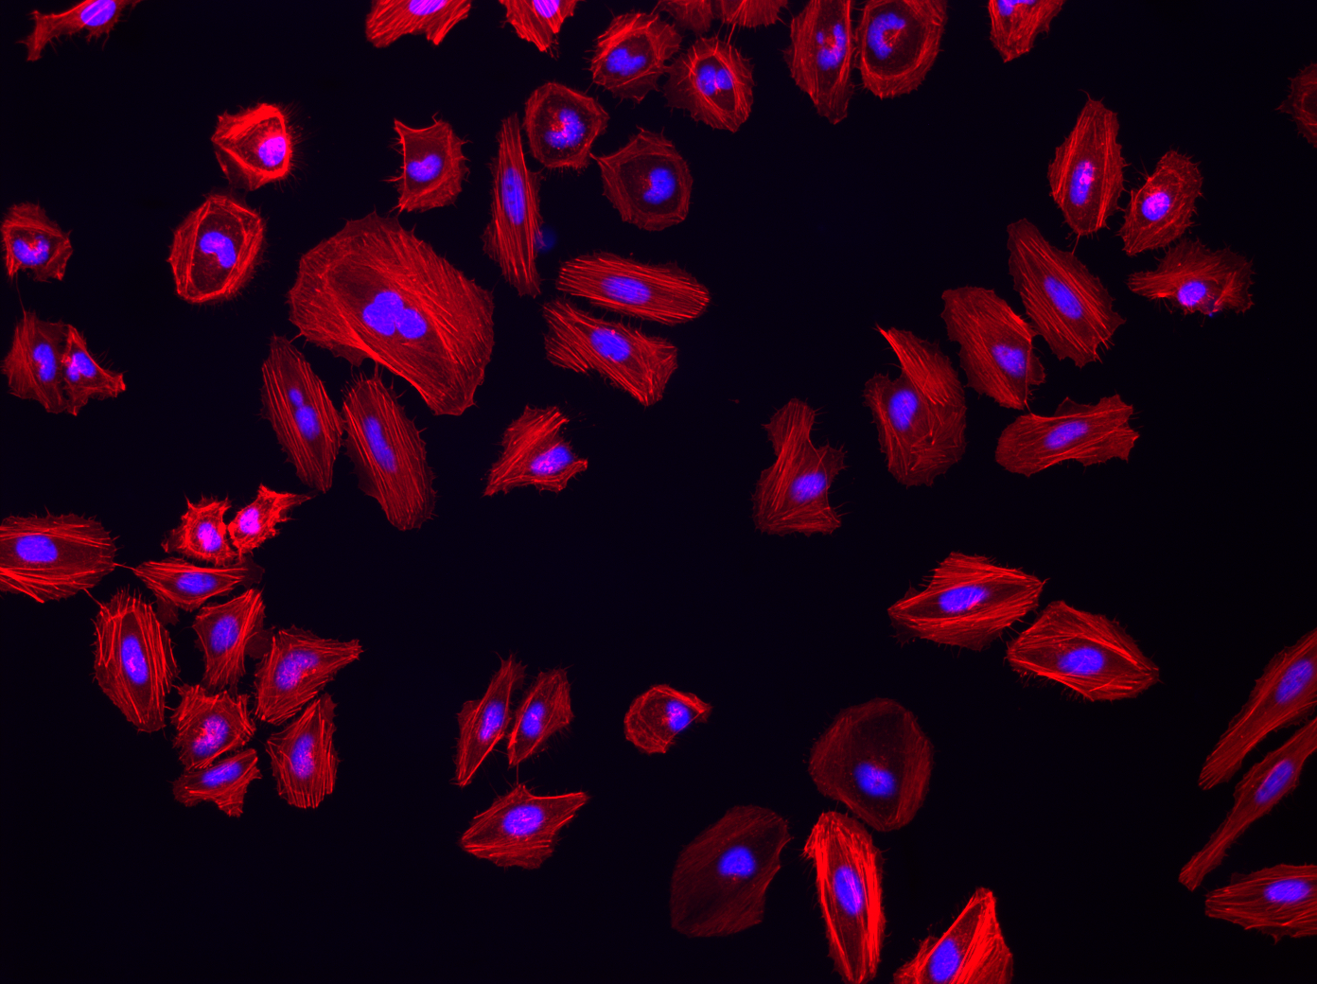





Thanks for Listening!
david.barry@crick.ac.uk
Introduction to automated object counting with…
Dale
Central 3 & 4
Stefania
Stay here!
Martin
Central 5, 6 & 7

